Slide 1
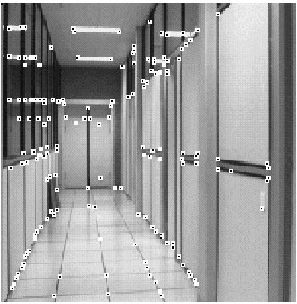
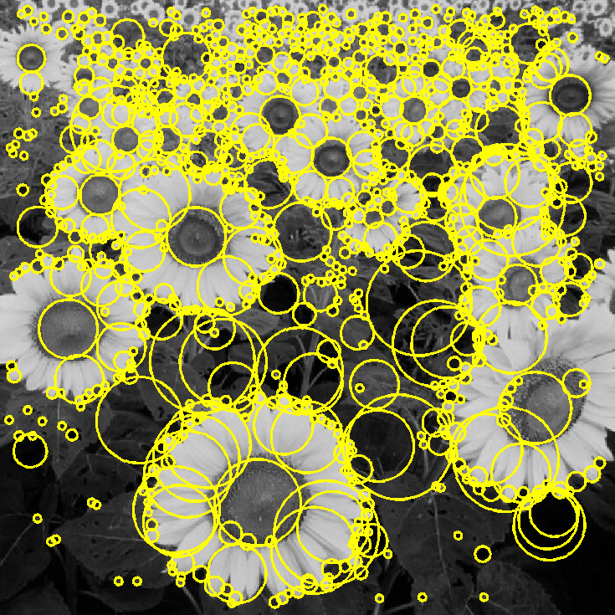
Feature extraction: Corners and blobs

Slide 2


Why extract features?
Motivation: panorama stitching
We have two images – how do we combine them?

Slide 3


Why extract features?
Motivation: panorama stitching
We have two images – how do we combine them?
Step 1: extract features
Step 2: match features

Slide 4
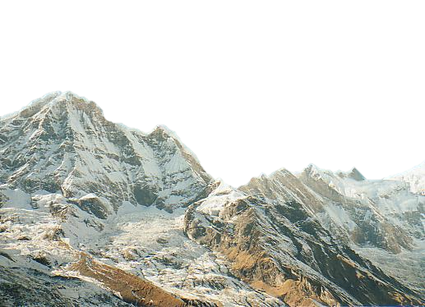
Why extract features?
Motivation: panorama stitching
We have two images – how do we combine them?
Step 1: extract features
Step 2: match features
Step 3: align images

Slide 5

Why extract features?
Motivation: panorama stitching
We have two images – how do we combine them?
Step 1: extract features
Step 2: match features
Step 3: align images

Slide 6
Characteristics of good features
Repeatability
The same feature can be found in several images despite geometric and photometric transformations
Saliency
Each feature has a distinctive description
Compactness and efficiency
Many fewer features than image pixels
Locality
A feature occupies a relatively small area of the image; robust to clutter and occlusion

Slide 7
Applications
Feature points are used for:
Motion tracking
Image alignment
3D reconstruction
Object recognition
Indexing and database retrieval
Robot navigation

Slide 8
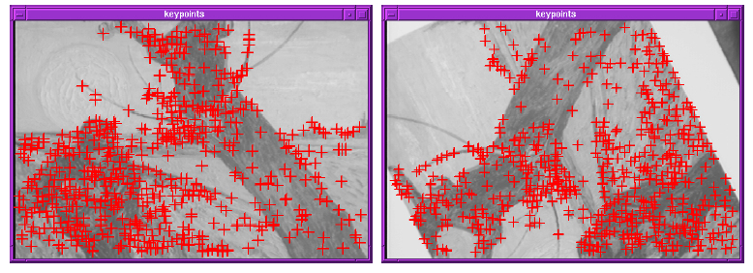
Finding Corners
Key property: in the region around a corner, image gradient has two or more dominant directions
Corners are repeatable and distinctive
C.Harris and M.Stephens. "A Combined Corner and Edge Detector.“ Proceedings of the 4th Alvey Vision Conference: pages 147--151.

Slide 9

The Basic Idea
We should easily recognize the point by looking through a small window
Shifting a window in any direction should give a large change in intensity
“flat” region: no change in all directions
“edge”: no change along the edge direction
“corner”: significant change in all directions
Source: A. Efros

Slide 10
Harris Detector: Mathematics
Change of intensity for the shift [u,v]:
Window function
Shifted intensity
Intensity
Window function w(x,y) =
or
1 in window, 0 outside
Gaussian
Source: R. Szeliski

Slide 11
Harris Detector: Mathematics
Change of intensity for the shift [u,v]:
Second-order Taylor expansion of E(u,v) about (0,0)
(bilinear approximation for small shifts):

Slide 12
Harris Detector: Mathematics
The bilinear approximation simplifies to
where M is a 2×2 matrix computed from image derivatives:
M

Slide 13
Interpreting the second moment matrix
First, consider an axis-aligned corner:

Slide 14
Interpreting the second moment matrix
First, consider an axis-aligned corner:
This means dominant gradient directions align with x or y axis
If either λ is close to 0, then this is not a corner, so look for locations where both are large.
Slide credit: David Jacobs

Slide 15
General Case
Since M is symmetric, we have
We can visualize M as an ellipse with axis lengths determined by the eigenvalues and orientation determined by R
direction of the fastest change
Ellipse equation:
direction of the slowest change
(λ_{max})^{-1/2}
(λ_{min})^{-1/2}

Slide 16
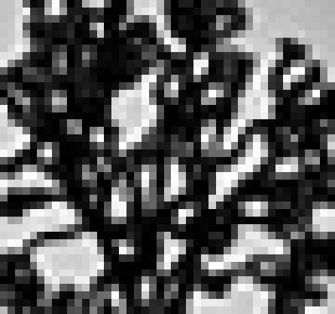
Visualization of second moment matrices

Slide 17
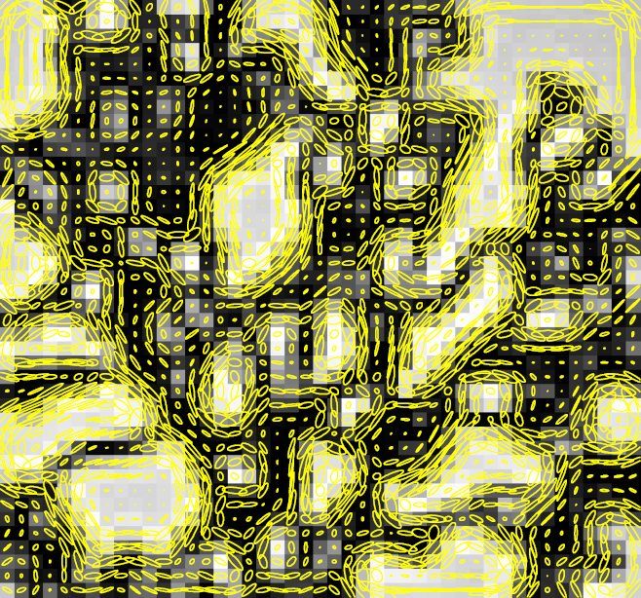
Visualization of second moment matrices

Slide 18
Interpreting the eigenvalues
Classification of image points using eigenvalues of M:
λ₂
“Edge” λ₂ >> λ₁
“Corner” λ₁ and λ₂ are large, λ₁ ~ λ₂; E increases in all directions
λ₁ and λ₂ are small; E is almost constant in all directions
“Flat” region
“Edge” λ₁ >> λ₂
λ₁

Slide 19
Corner response function
α: constant (0.04 to 0.06)
“Edge” R < 0
“Corner” R > 0
|R| small
“Flat” region
“Edge” R < 0

Slide 20

Harris Detector: Steps

Slide 21

Harris Detector: Steps
Compute corner response R

Slide 22

Harris Detector: Steps
Find points with large corner response: R>threshold

Slide 23

Harris Detector: Steps
Take only the points of local maxima of R

Slide 24

Harris Detector: Steps

Slide 25
Harris detector: Summary of steps
Compute Gaussian derivatives at each pixel
Compute second moment matrix M in a Gaussian window around each pixel
Compute corner response function R
Threshold R
Find local maxima of response function (nonmaximum suppression)

Slide 26
Invariance
We want features to be detected despite geometric or photometric changes in the image: if we have two transformed versions of the same image, features should be detected in corresponding locations

Slide 27
Models of Image Change
Geometric
Rotation
Scale
Affine valid for: orthographic camera, locally planar object
Photometric
Affine intensity change (I → a I + b)

Slide 28
Harris Detector: Invariance Properties
Rotation
Ellipse rotates but its shape (i.e. eigenvalues) remains the same
Corner response R is invariant to image rotation

Slide 29
Harris Detector: Invariance Properties
Affine intensity change
Only derivatives are used => invariance to intensity shift I → I + b
Intensity scale: I → a I
R
R
threshold
x (image coordinate)
x (image coordinate)
Partially invariant to affine intensity change

Slide 30
Harris Detector: Invariance Properties
Scaling
Corner
All points will be classified as edges
Not invariant to scaling

Slide 31
Scale-invariant feature detection
Goal: independently detect corresponding regions in scaled versions of the same image
Need scale selection mechanism for finding characteristic region size that is covariant with the image transformation

Slide 32
Scale-invariant features: Blobs

Slide 33
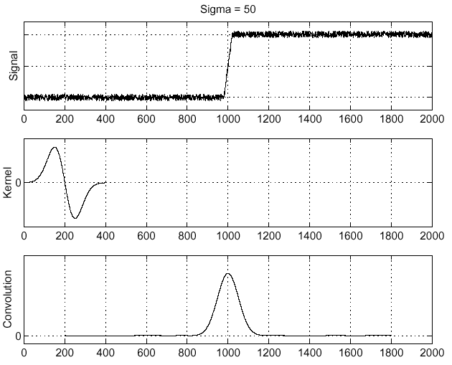
Recall: Edge detection
Edge
f
Derivative of Gaussian
Edge = maximum of derivative
Source: S. Seitz

Slide 34
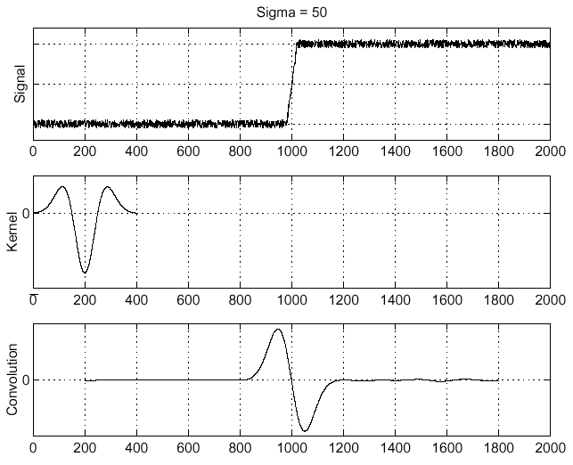
Edge detection, Take 2
f
Edge
Second derivative of Gaussian (Laplacian)
Edge = zero crossing of second derivative
Source: S. Seitz

Slide 35
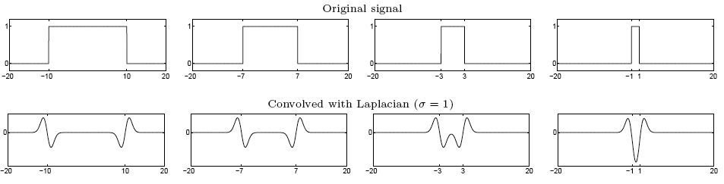
From edges to blobs
Edge = ripple
Blob = superposition of two ripples
maximum
Spatial selection: the magnitude of the Laplacian response will achieve a maximum at the center of the blob, provided the scale of the Laplacian is “matched” to the scale of the blob

Slide 36
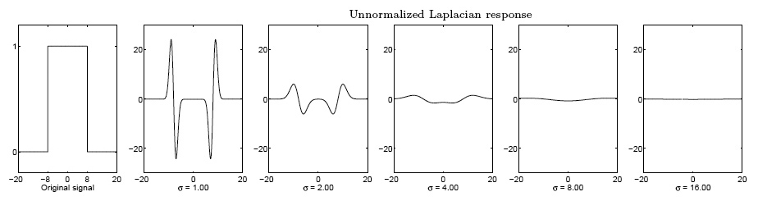
Scale selection
We want to find the characteristic scale of the blob by convolving it with Laplacians at several scales and looking for the maximum response
However, Laplacian response decays as scale increases:
original signal (radius=8)
increasing σ
Why does this happen?

Slide 37
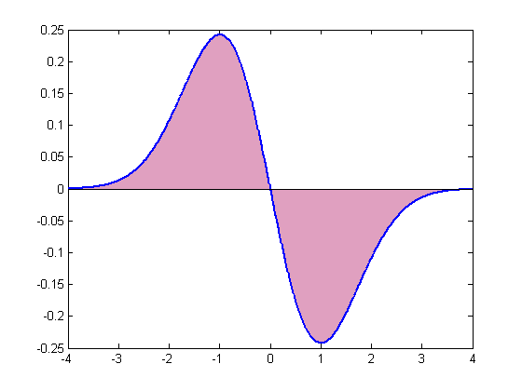
Scale normalization
The response of a derivative of Gaussian filter to a perfect step edge decreases as σ increases

Slide 38
Scale normalization
The response of a derivative of Gaussian filter to a perfect step edge decreases as σ increases
To keep response the same (scale-invariant), must multiply Gaussian derivative by σ
Laplacian is the second Gaussian derivative, so it must be multiplied by σ²

Slide 39
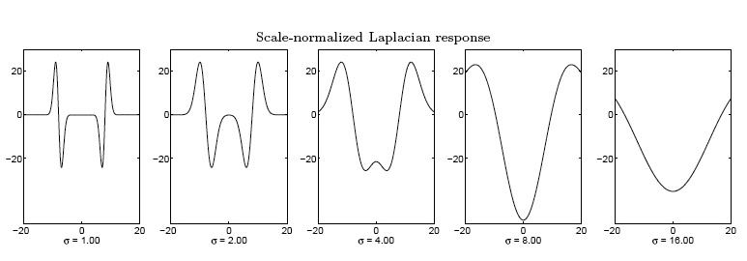
Effect of scale normalization
Original signal
Unnormalized Laplacian response
Scale-normalized Laplacian response
maximum

Slide 40
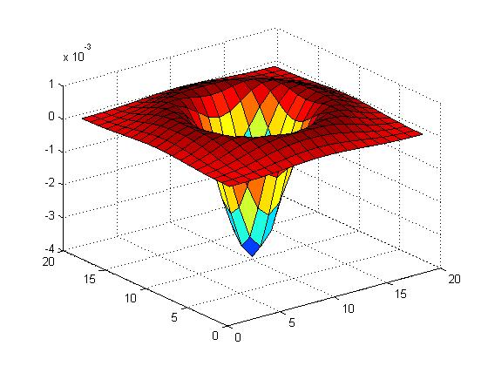

Blob detection in 2D
Laplacian of Gaussian: Circularly symmetric operator for blob detection in 2D

Slide 41
Blob detection in 2D
Laplacian of Gaussian: Circularly symmetric operator for blob detection in 2D
Scale-normalized:

Slide 42
Scale selection
The 2D Laplacian is given by
Therefore, for a binary circle of radius r, the Laplacian achieves a maximum at
(up to scale)
r
Laplacian response
scale (σ)
image

Slide 43
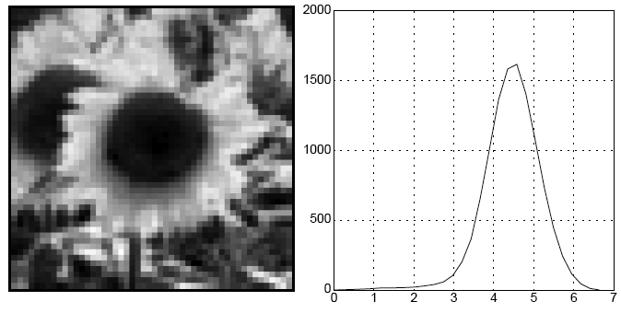
Characteristic scale
We define the characteristic scale as the scale that produces peak of Laplacian response
characteristic scale
T. Lindeberg (1998). "Feature detection with automatic scale selection." International Journal of Computer Vision 30 (2): pp 77--116.

Slide 44
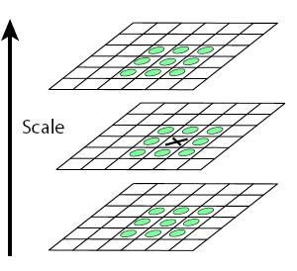
Scale-space blob detector
Convolve image with scale-normalized Laplacian at several scales
Find maxima of squared Laplacian response in scale-space

Slide 45
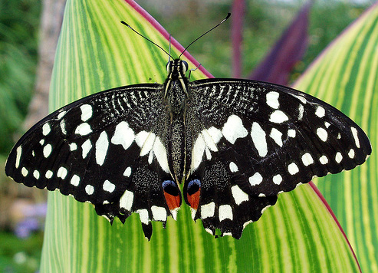
Scale-space blob detector: Example

Slide 46
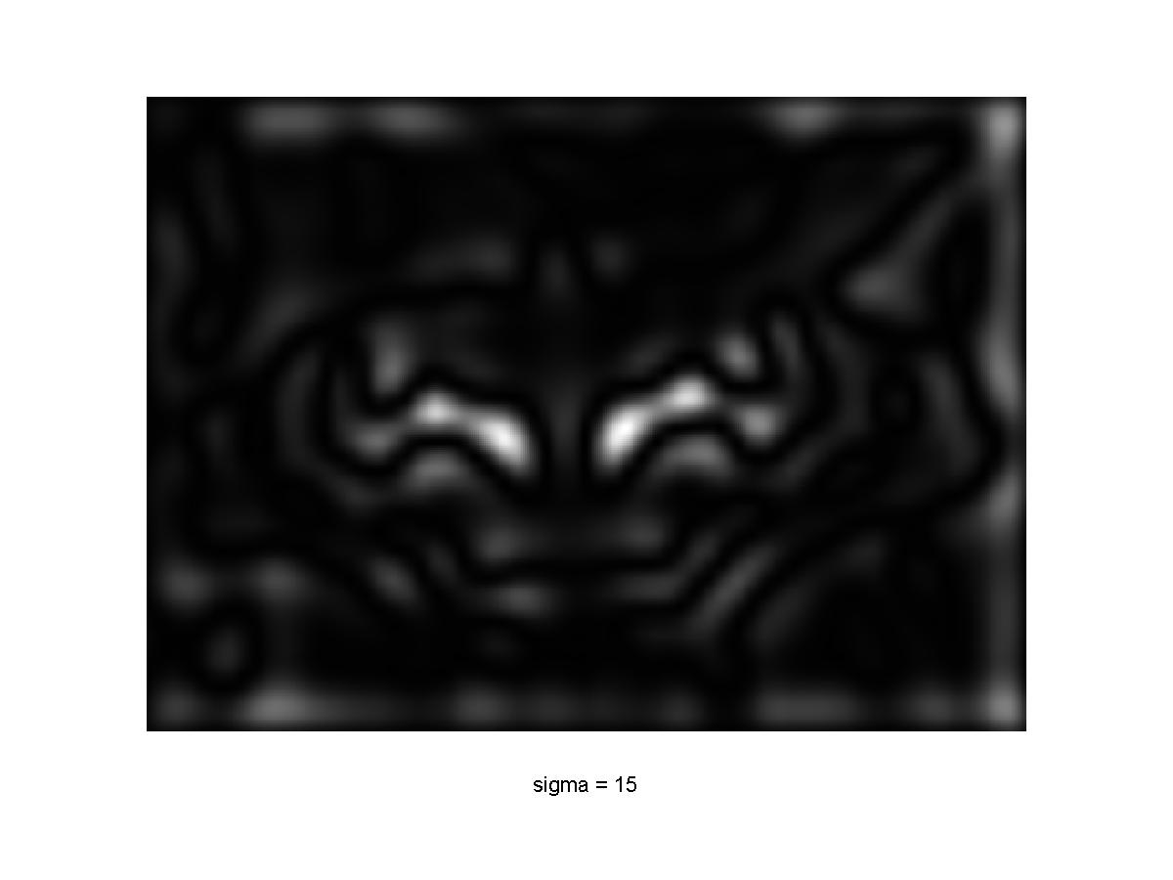
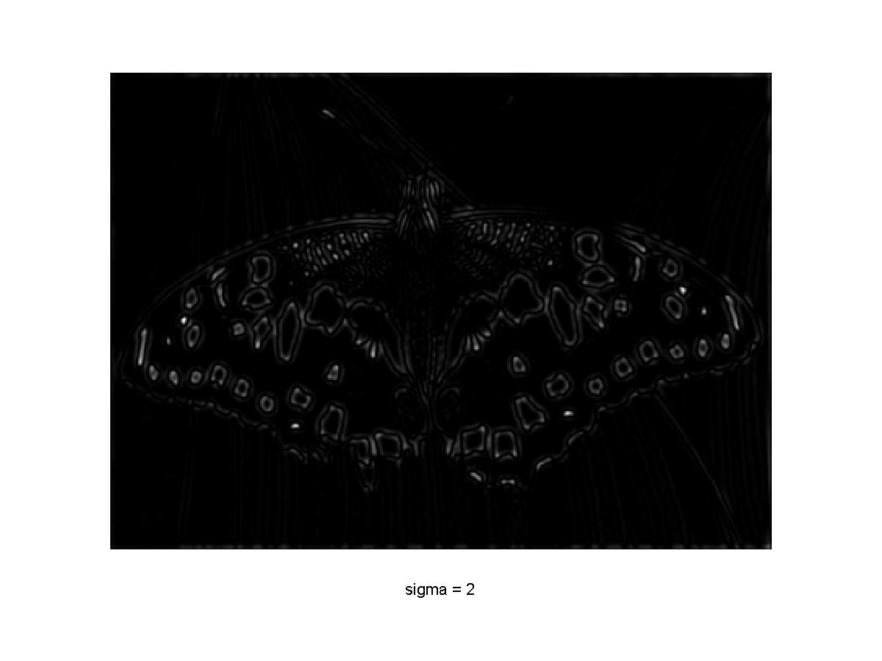
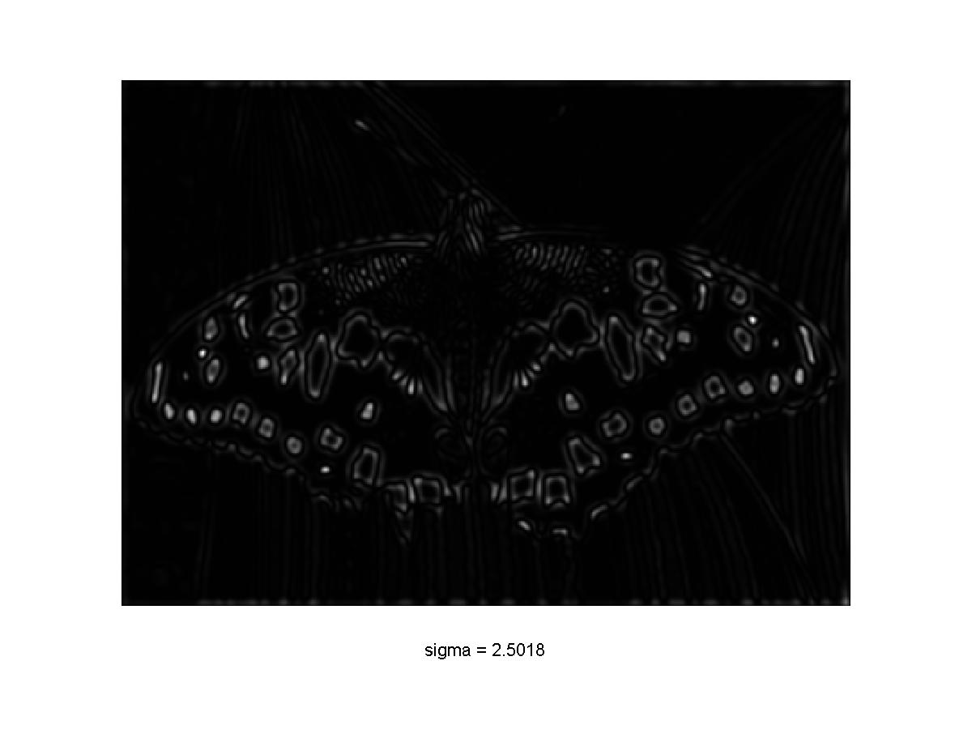
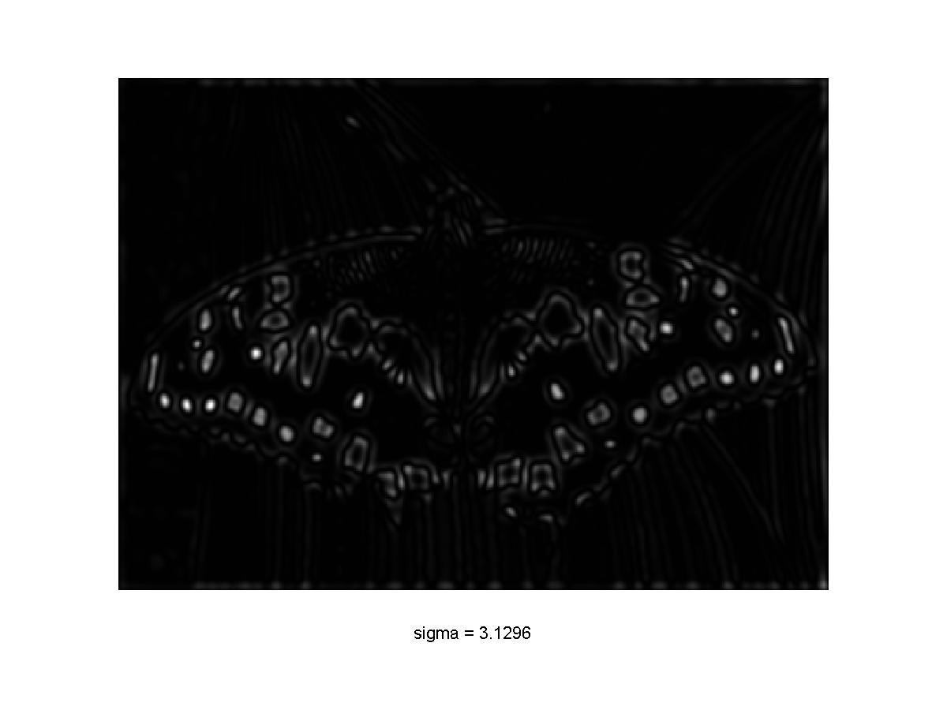
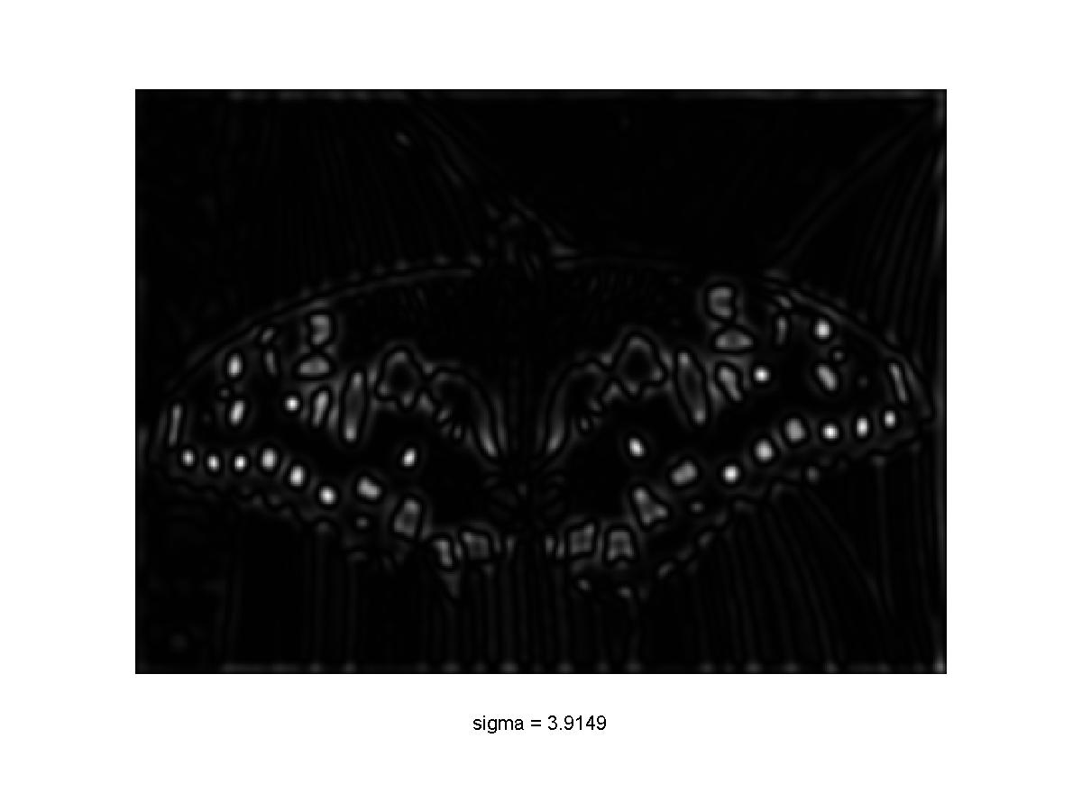
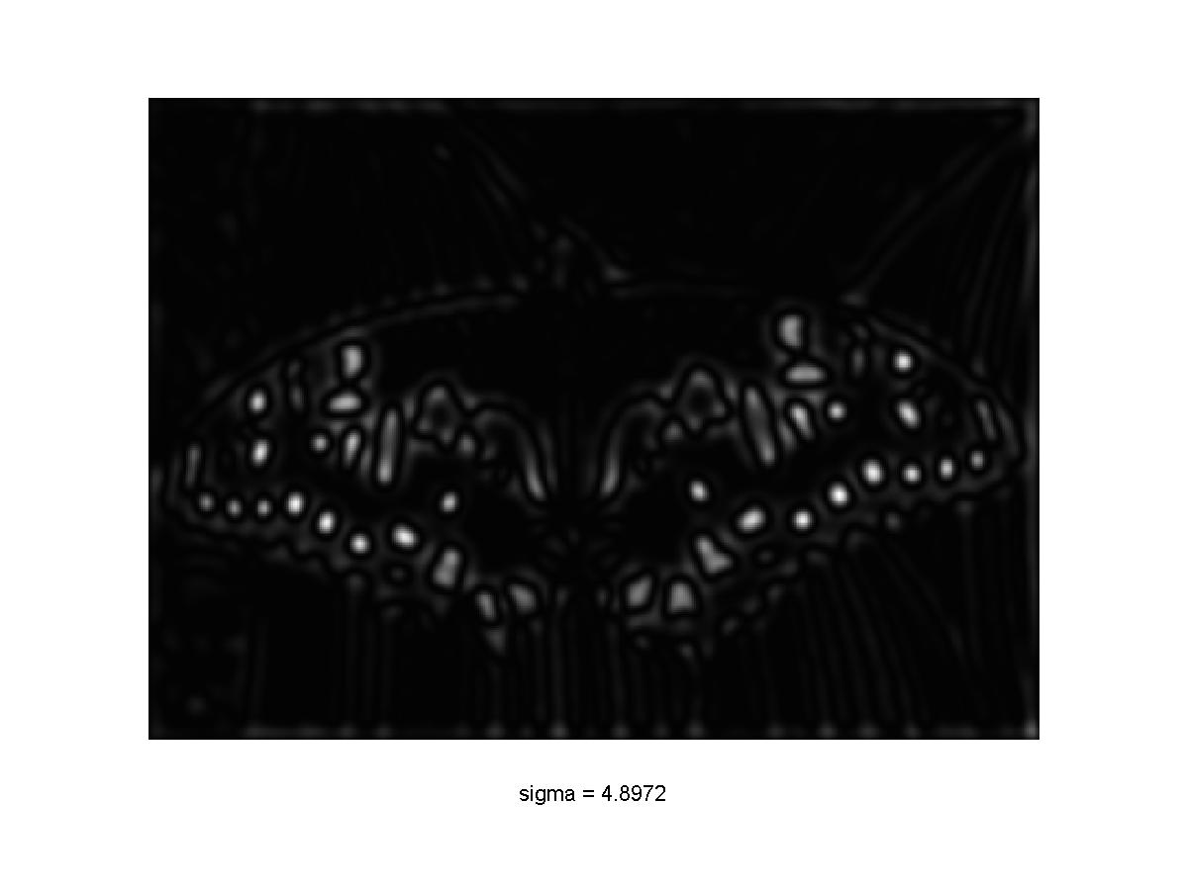

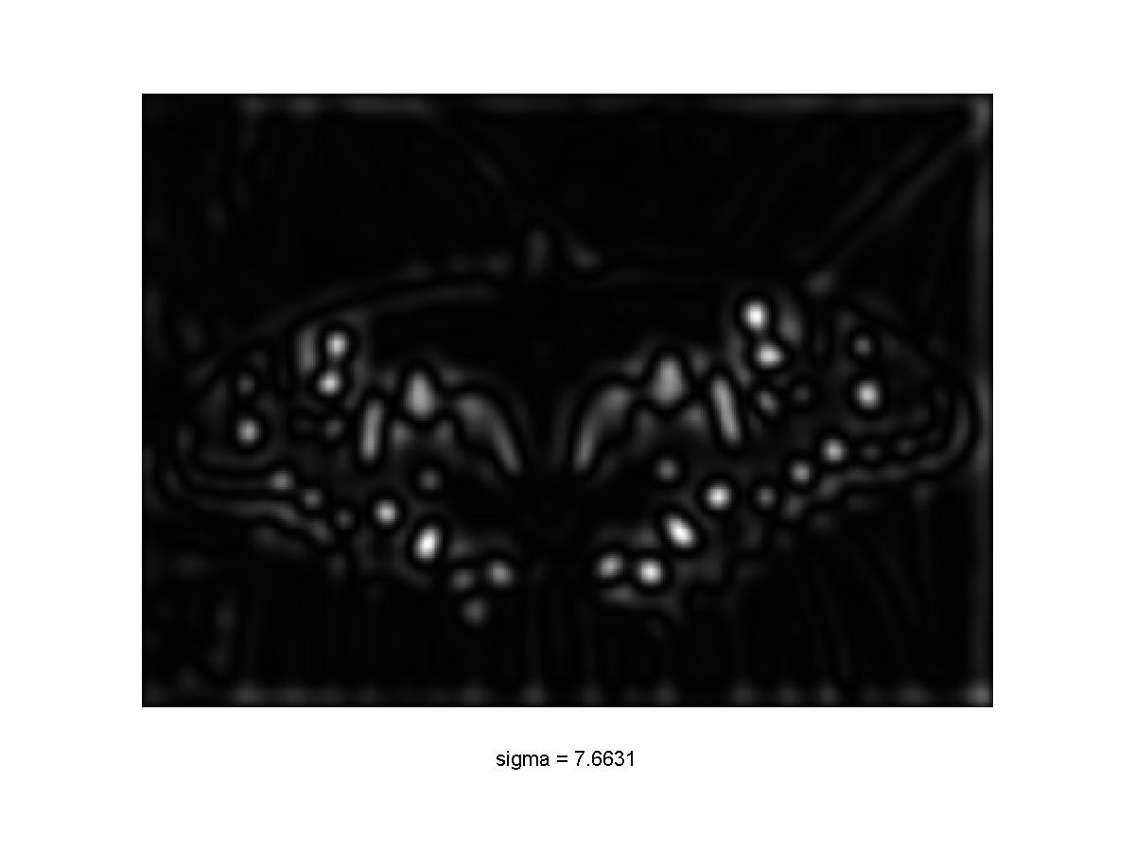
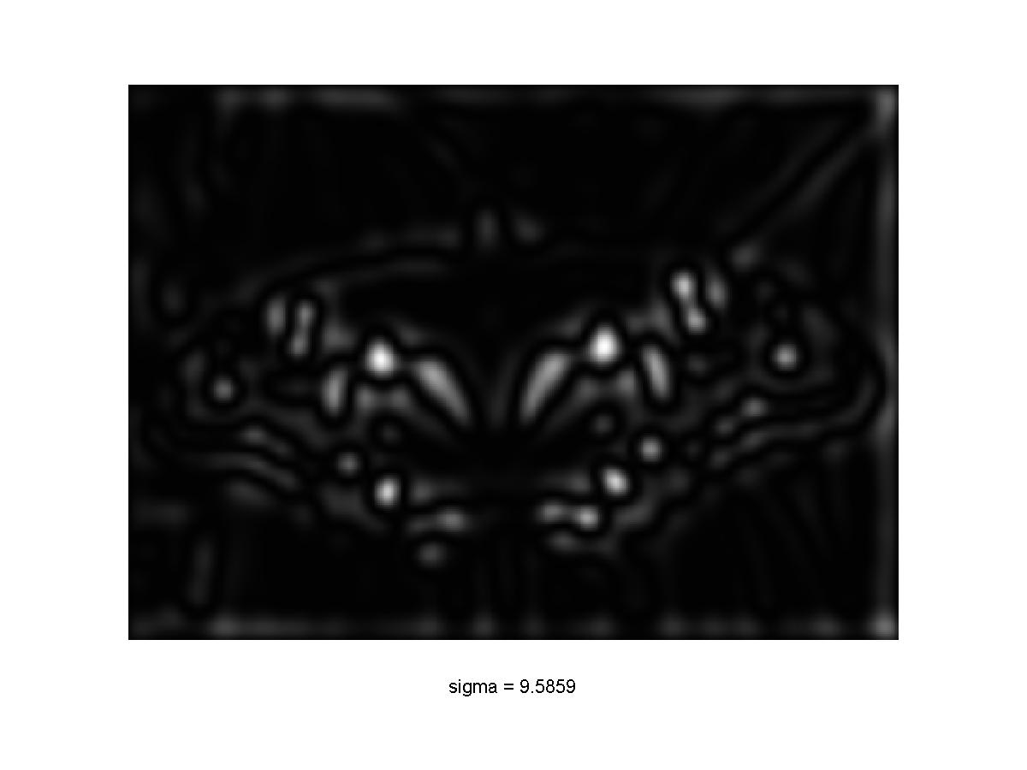
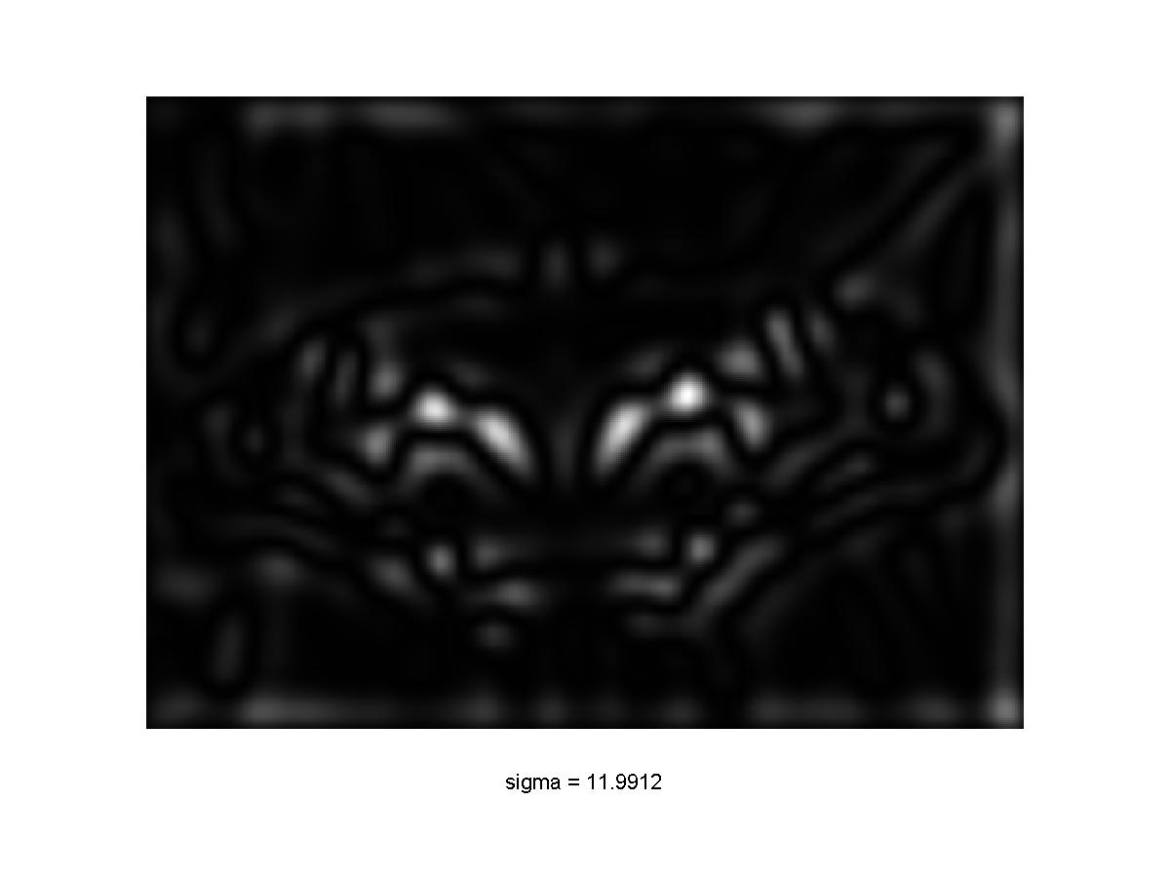
Scale-space blob detector: Example

Slide 47
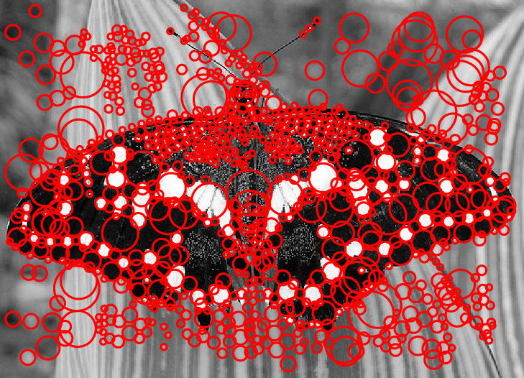
Scale-space blob detector: Example

Slide 48
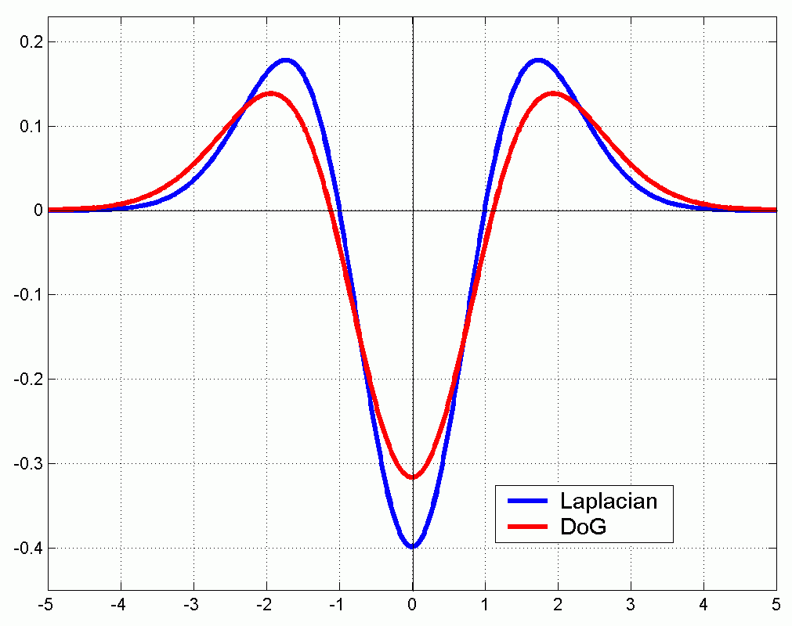
Efficient implementation
Approximating the Laplacian with a difference of Gaussians:
(Laplacian)
(Difference of Gaussians)

Slide 49
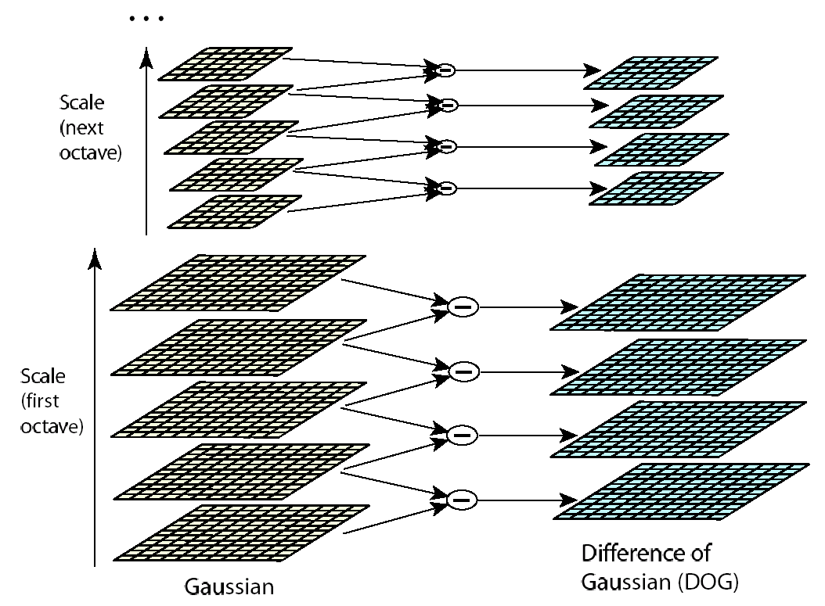
Efficient implementation
David G. Lowe. "Distinctive image features from scale-invariant keypoints.” IJCV 60 (2), pp. 91-110, 2004.

Slide 50
Matching feature points
We know how to detect good points
Next question: How to match them?
Two interrelated questions:
How do we describe each feature point?
How do we match descriptions?
?

Slide 51
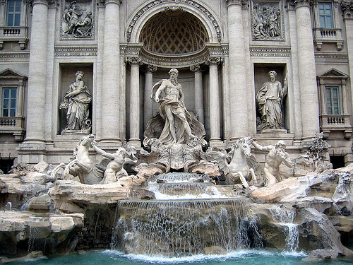
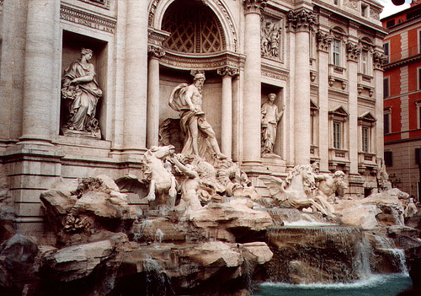
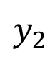
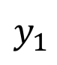
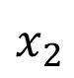
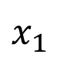
Feature descriptor
$$x_{1}$$
$$x_{2}$$
$$y_{1}$$
$$y_{2}$$

Slide 52
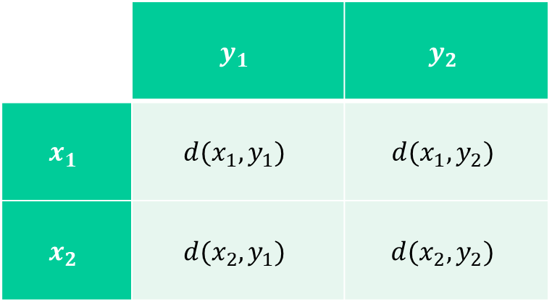
Feature matching
Measure the distance between (or similarity between) every pair of descriptors
 | $$y_{1}$$ | $$y_{2}$$
$$x_{1}$$ | $$d(x_{1},y_{1})$$ | $$d(x_{1},y_{2})$$
$$x_{2}$$ | $$d(x_{2},y_{1})$$ | $$d(x_{2},y_{2})$$

Slide 53
Invariance vs. discriminability
Invariance:
Distance between descriptors should be small even if image is transformed
Discriminability:
Descriptor should be highly unique for each point (far away from other points in the image)

Slide 54
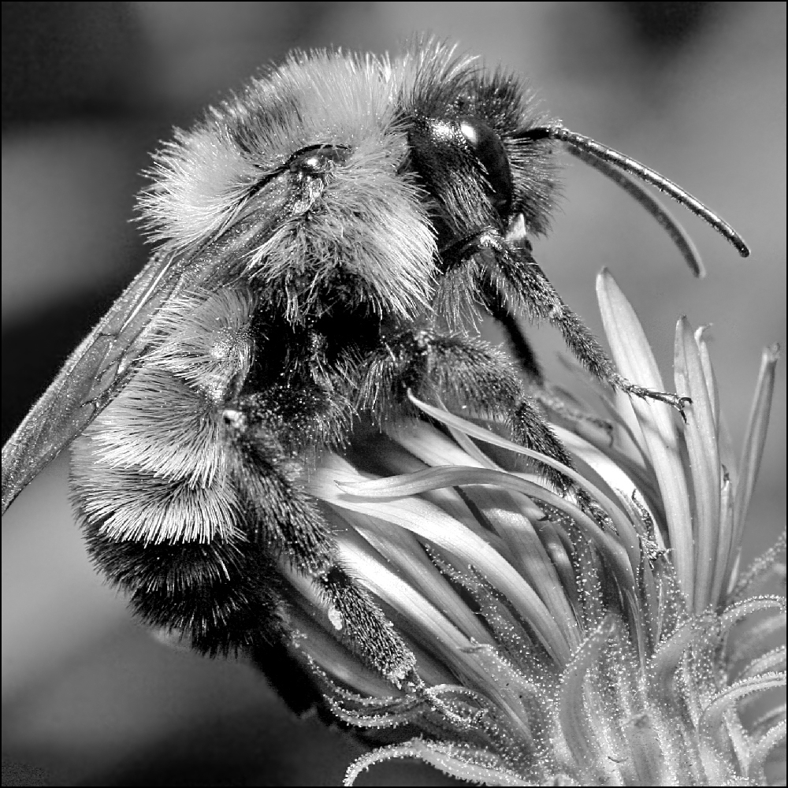
Image transformations
Geometric
Rotation
Scale
Photometric
Intensity change

Slide 55
Invariance
Most feature descriptors are designed to be invariant to
Translation, 2D rotation, scale
They can usually also handle
Limited 3D rotations (SIFT works up to about 60 degrees)
Limited affine transformations (some are fully affine invariant)
Limited illumination/contrast changes

Slide 56
How to achieve invariance
Design an invariant feature descriptor
Simplest descriptor: a single 0
What’s this invariant to?
Is this discriminative?
Next simplest descriptor: a single pixel
What’s this invariant to?
Is this discriminative?

Slide 57

The aperture problem

Slide 58
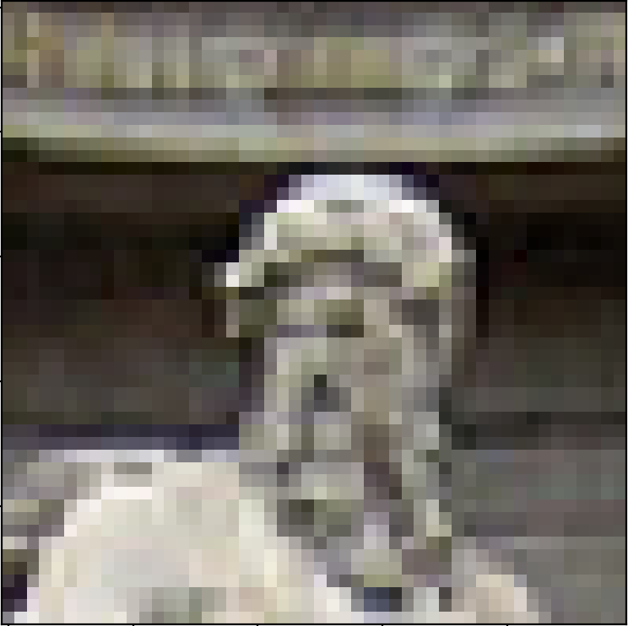
The aperture problem
Use a whole patch instead of a pixel?

Slide 59
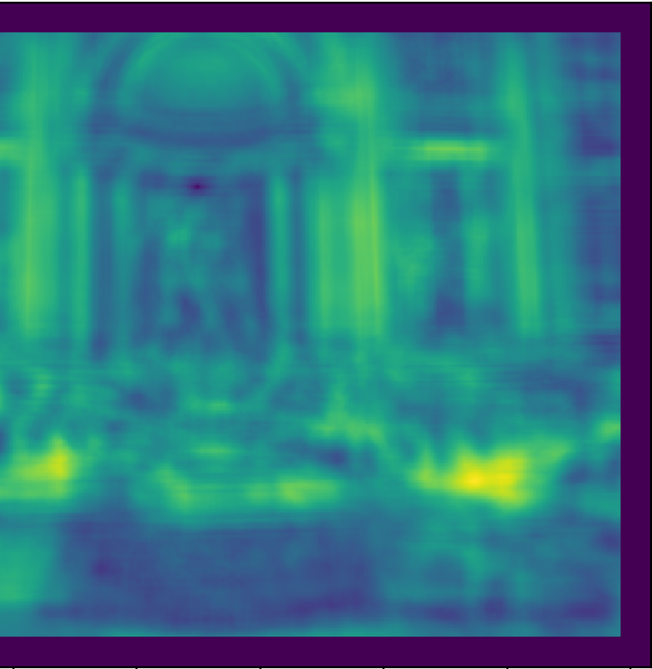
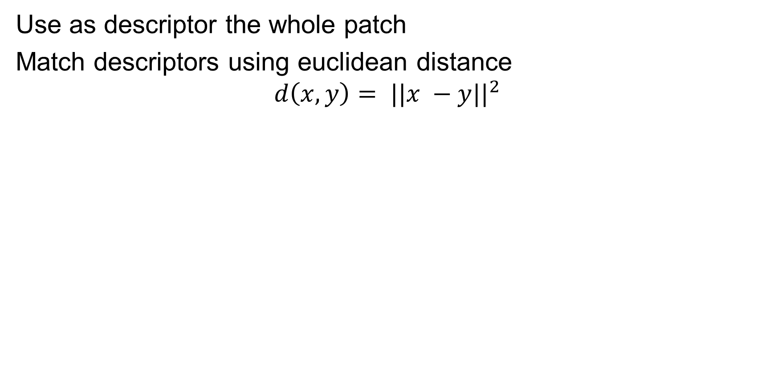
SSD
Use as descriptor the whole patch
Match descriptors using euclidean distance
$$d\left(x,y\right)= ||x −y||^{2}$$

Slide 60
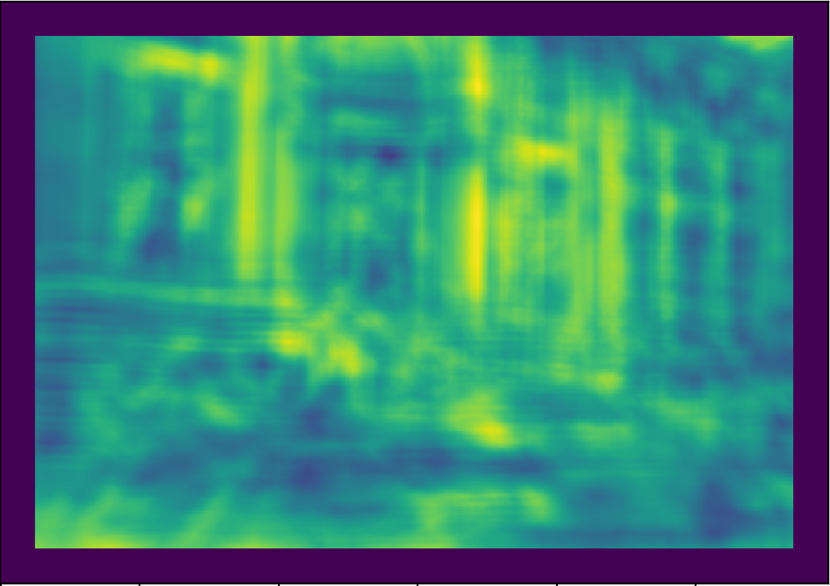
SSD

Slide 61
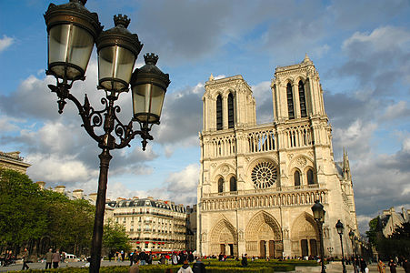
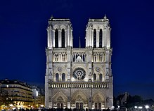
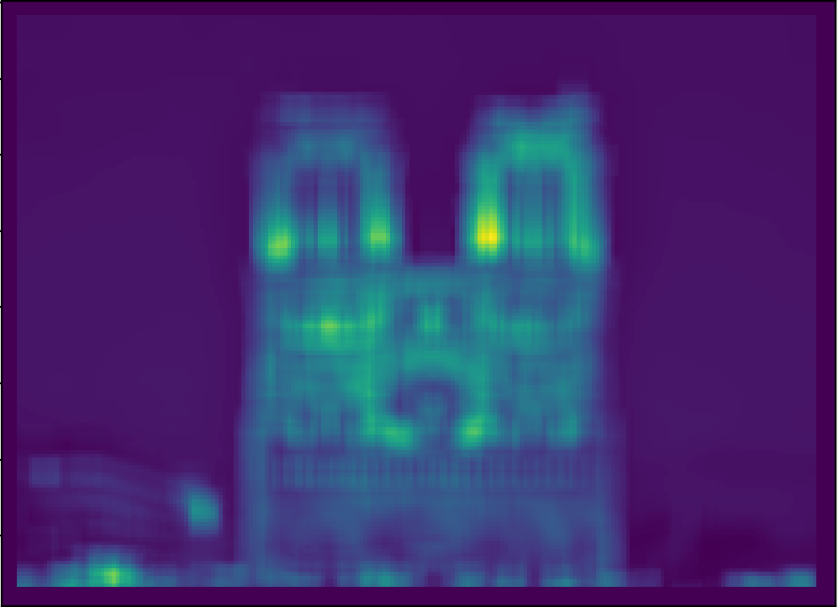

SSD

Slide 62
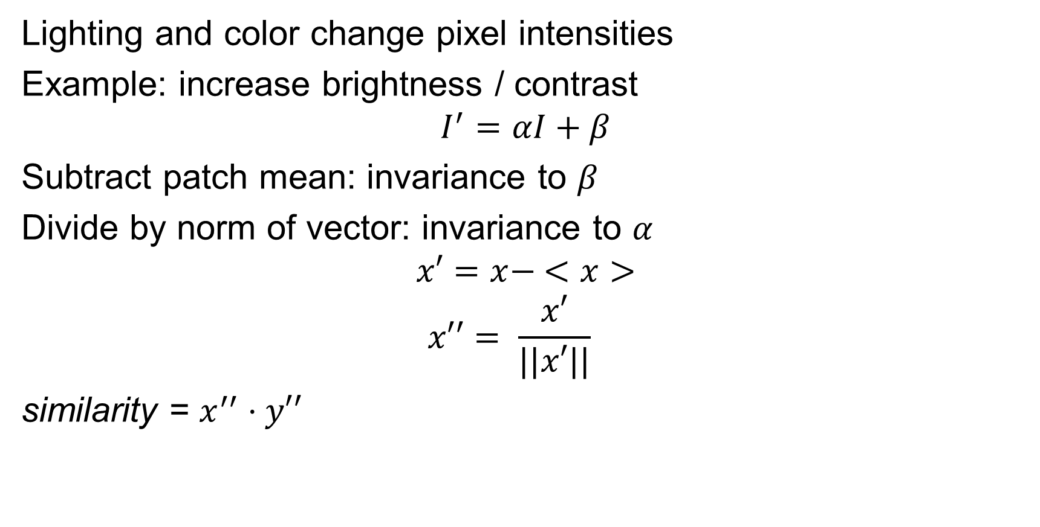
NCC - Normalized Cross Correlation
Lighting and color change pixel intensities
Example: increase brightness / contrast
$$I^{′}=αI+β$$
Subtract patch mean: invariance to $β$
Divide by norm of vector: invariance to $α$
$$x′=x− <x>$$
$$x′′= \frac{x′}{||x′||}$$
similarity = $x^{′′}⋅y′′$

Slide 63
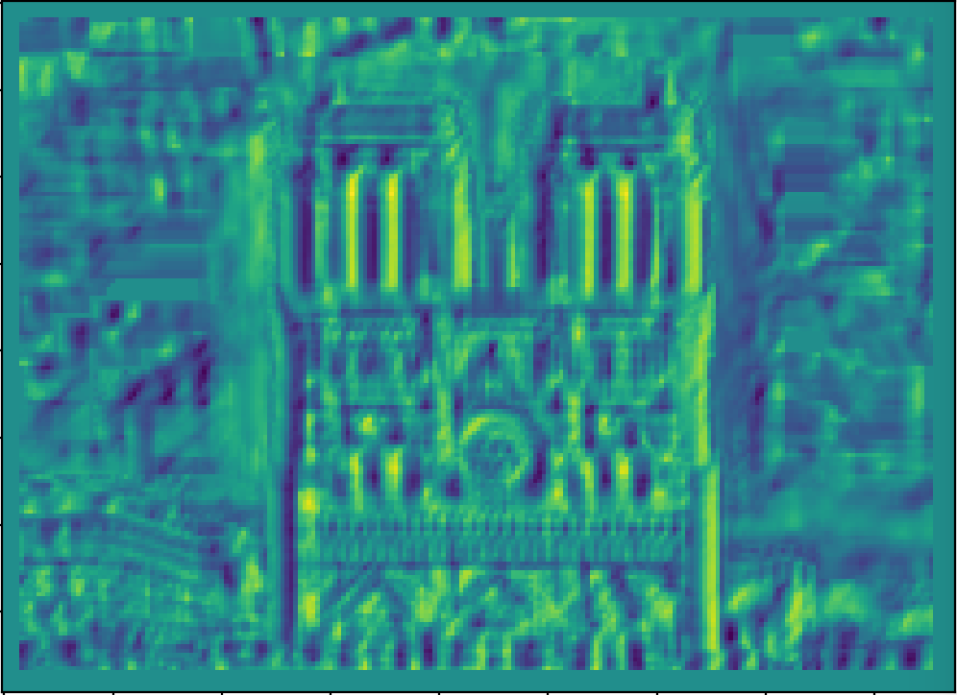
NCC - Normalized cross correlation

Slide 64
Basic correspondence
Image patch as descriptor, NCC as similarity
Invariant to?
Photometric transformations?
Translation?
Rotation?

Slide 65
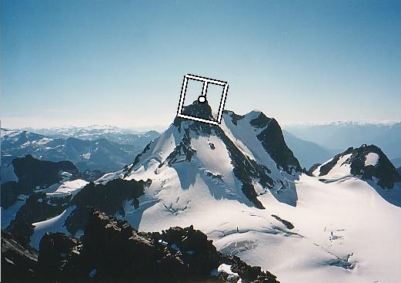
Rotation invariance for feature descriptors
Find dominant orientation of the image patch
This is given by x_{max}, the eigenvector of M corresponding to λ_{max} (the larger eigenvalue)
Rotate the patch according to this angle
Figure by Matthew Brown

Slide 66
Color and Lighting

Slide 67
Towards a better feature descriptor
Match pattern of edges
Edge orientation – clue to shape
Be resilient to small deformations
Deformations might move pixels around, but slightly
Deformations might change edge orientations, but slightly

Slide 68
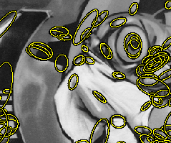
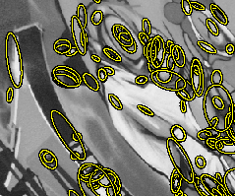
From scale invariance to affine invariance

Slide 69
Affine adaptation
Recall:
We can visualize M as an ellipse with axis lengths determined by the eigenvalues and orientation determined by R
direction of the fastest change
Ellipse equation:
direction of the slowest change
(λ_{max})^{-1/2}
(λ_{min})^{-1/2}

Slide 70
Affine adaptation
The second moment ellipse can be viewed as the “characteristic shape” of a region
We can normalize the region by transforming the ellipse into a unit circle

Slide 71
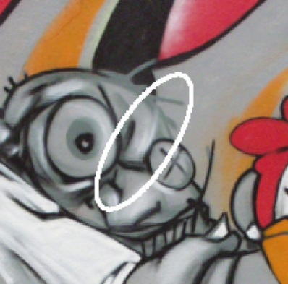
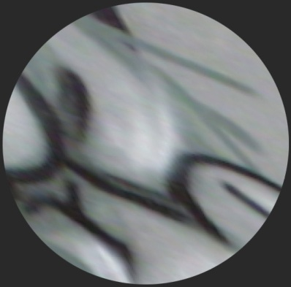


Orientation ambiguity
There is no unique transformation from an ellipse to a unit circle
We can rotate or flip a unit circle, and it still stays a unit circle

Slide 72

Orientation ambiguity
There is no unique transformation from an ellipse to a unit circle
We can rotate or flip a unit circle, and it still stays a unit circle
So, to assign a unique orientation to keypoints:
Create histogram of local gradient directions in the patch
Assign canonical orientation at peak of smoothed histogram
0
2
π

Slide 73
Affine adaptation
Problem: the second moment “window” determined by weights w(x,y) must match the characteristic shape of the region
Solution: iterative approach
Use a circular window to compute second moment matrix
Perform affine adaptation to find an ellipse-shaped window
Recompute second moment matrix using new window and iterate

Slide 74
Iterative affine adaptation
K. Mikolajczyk and C. Schmid, Scale and Affine invariant interest point detectors, IJCV 60(1):63-86, 2004.
http://www.robots.ox.ac.uk/~vgg/research/affine/

Slide 75
Affine adaptation example
Scale-invariant regions (blobs)

Slide 76

Affine adaptation example
Affine-adapted blobs

Slide 77








Summary: Affine adaptation
Eliminate rotational
ambiguity
Compute appearance descriptors
Extract affine regions
Normalize regions
SIFT (Lowe ’04)

Slide 78

The SIFT descriptor
Compute edge magnitudes + orientations
Quantize orientations (invariance to def)
Divide into spatial cells
Compute orientation histogram in each cell (spatial invariance)
Distinctive Image Features from Scale-Invariant Keypoints. Lowe. In IJCV 2004

Slide 79


Properties of SIFT
Extraordinarily robust matching technique
Can handle changes in viewpoint
Up to about 60 degree out of plane rotation
Can handle significant changes in illumination
Sometimes even day vs. night (below)
Fast and efficient—can run in real time
Lots of code available: http://people.csail.mit.edu/albert/ladypack/wiki/index.php/Known_implementations_of_SIFT

Slide 80

Which features match?

Slide 81
Feature matching
Given a feature in I₁, how to find the best match in I₂?
Define distance function that compares two descriptors
Test all the features in I₂, find the one with min distance

